Slide 1
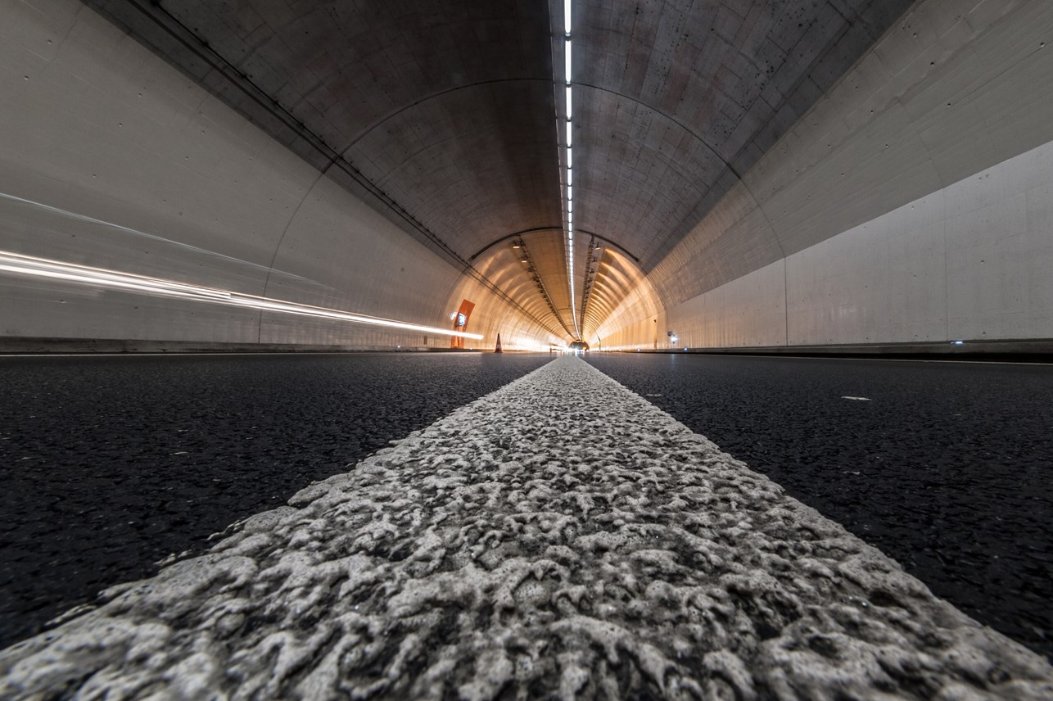
SIGRIST sensor for early fire/smoke detection in tunnels:
FireGuard

Slide 2
Content
SIGRIST history and success in tunnels
Basics for early fire/smoke detection
System requirements for an early fire/smoke detection
Swiss FEDRO standard for fire detection
Measuring methods / measuring principle smoke detector
FireGuard:
  Sensor, installation, system integration, parameterisation,
  service & maintenance

Slide 3
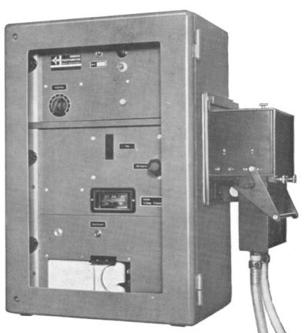
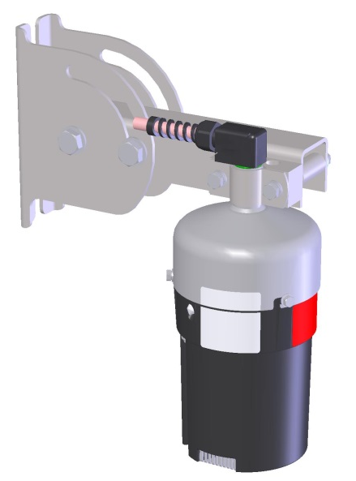
SIGRIST history in tunnels
1968: Entry into the tunnel market with the first visibility monitor of the “UP series”
2007: Market introduction of the fire/smoke detector “FireGuard”
2016: Market introduction of the fire/smoke detector “FireGuard2”

Slide 4
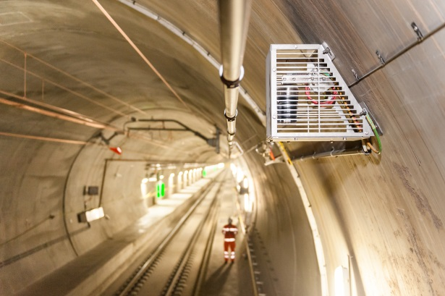
SIGRIST success in tunnels
Convincing concept of the FireGuard:
  After a successful field test, the Gotthard tunnel was immediately equipped with the first series of 210 sensors
  In 2009 SIGRIST won the 3rd price in the innovation contest of central Switzerland
  In Switzerland, almost all new and upgraded tunnels are equipped with FireGuard sensors
  In 2015 SIGRIST received an order to install FireGuard sensors in the multi-functional stations of the new NEAT (Gotthard) railway tunnel
Until today, more than 2’500 FireGuard
sensors have been installed

Slide 5
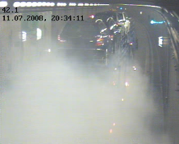
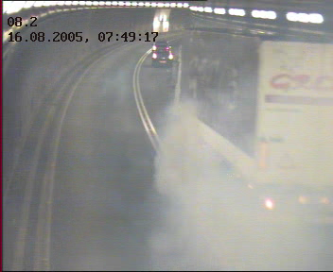
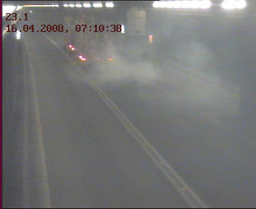
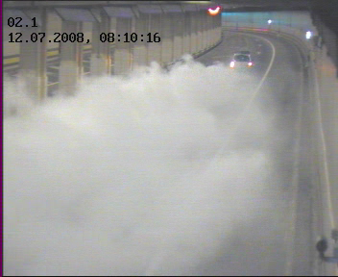
Basics for early fire/smoke detection
Most fire incidents in tunnels start with smoke
The main reasons are:
  Overheated turbo charger (mainly in HGV!)
  Blocked brakes, axles, tyres
  Fault / short-cut in the electronics
In many cases there’s no fire at all, only smoke
  Example incident Gotthard tunnel, 14.1.14: blocked axle on a semi-trailer truck
Turbo damage
Blocked brake
Defective tire
Motor damage

Slide 6
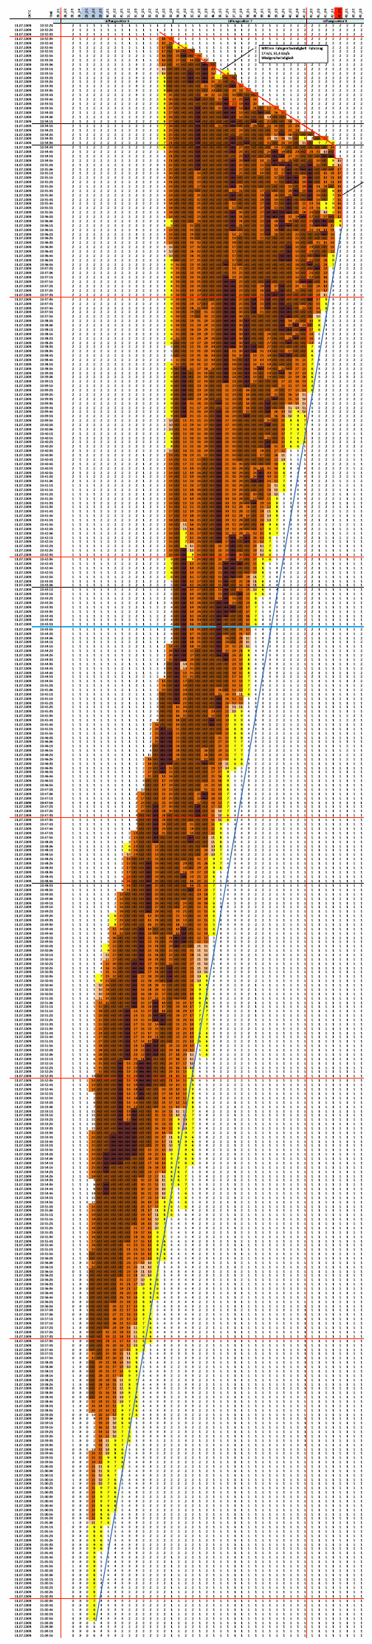
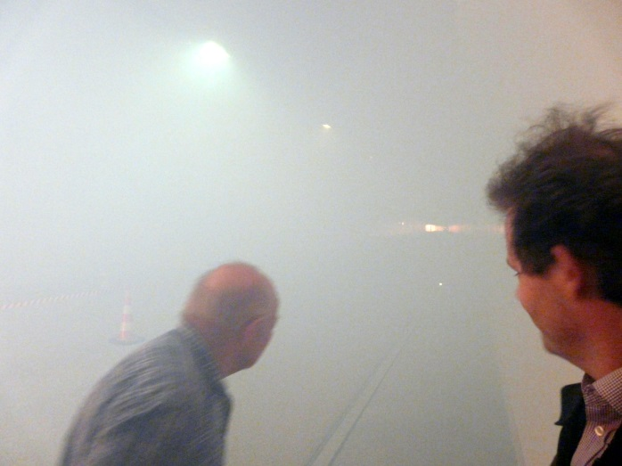
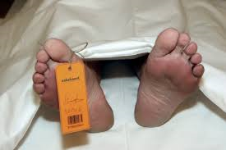
Basics for early fire/smoke detection
Smoke spreads very quickly
Visibility is rapidly and drastically reduced
The reaction of the drivers is mostly wrong:
  Uncontrolled
  Chaotic, Anarchistic, motto: “just get away”
  Rules and regulations are no longer respected
People are killed by the poisonous gases

Slide 7
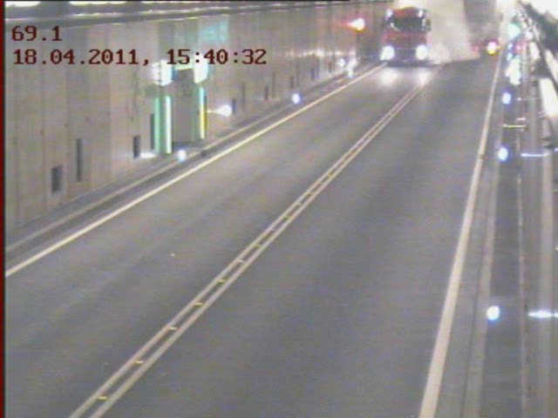
Basics for early fire/smoke detection

Slide 8
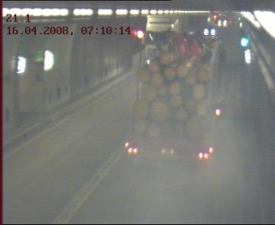
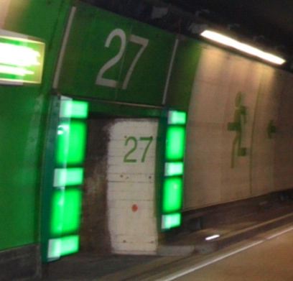
System requirements for an early fire/smoke detection
Reliable detection of smoke and fire in an early state
A system, which allows people to reach the safety shelters as quick as possible (self rescue); normally there’s a maximum time of 3 minutes!
A system which allows localizing exactly the place of the fire
A system which doesn’t trigger false alarms
A system which is simple and economically with a minimum requirement on maintenance

Slide 9

Swiss FEDRO standard for smoke/fire detection
Goal: to detect a fire within one minute
Installation density of smoke detectors:
  Tunnel with smoke extraction; one smoke detector on each damper must be installed
  Tunnels without smoke extraction: the recommended distance between smoke detectors should be 100 meters
The resolution of the linear fire cable must not exceed 10 meters
The automatic fire detection system must not trigger more than 1 faulty alarm per 2 kilometre per year
Fog must not be detected as smoke

Slide 10
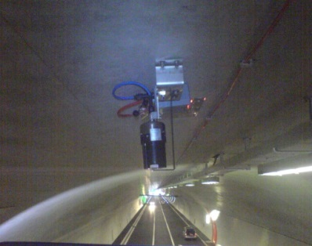
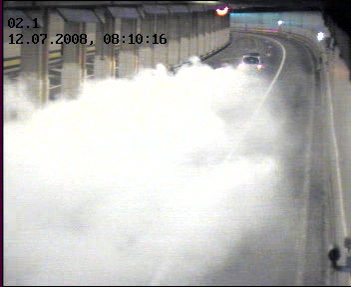

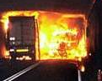
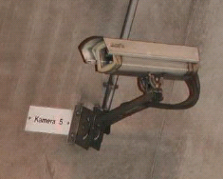
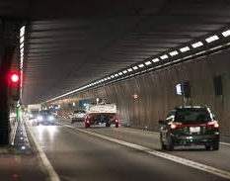
Measuring methods
Smoke Detectors:
  Detection of smouldering fire
  Distinguish between a moving vehicle and a vehicle standing still
Linear fire cable:
  Detection of an open fire
  Exact localisation of the incident
Video Detection:
  Traffic flow
  Ghost drivers
  Accidents / break downs

Slide 11
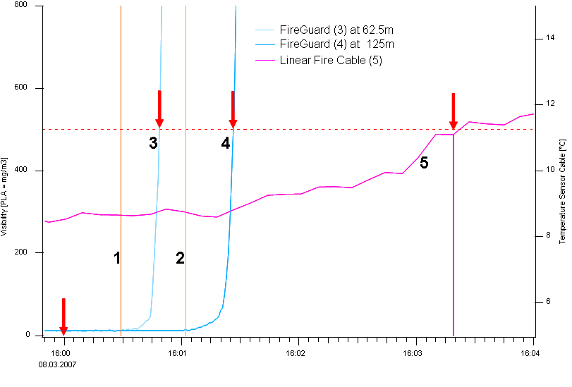
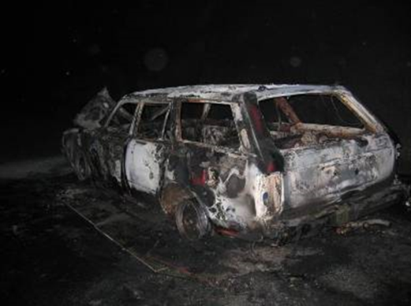
Comparison: smoke detector vs. linear fire cable*
Time delay linear fire cable: 2.5 minutes
*Test in the “Runehamar tunnel”, Norway - 2007
Fire in a car (realistic incident): the smoke detector triggered the alarm after about 40 seconds. The linear fire cable only after more than 3 minutes! Reason: in the beginning, only smoke was developed (this is fact for most incidents)

Slide 12
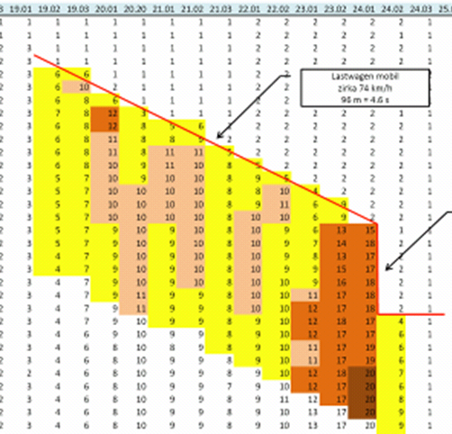
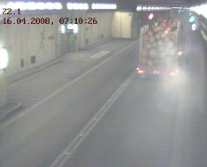
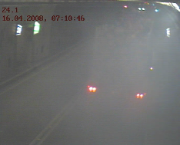
Comparison: smoke detector vs. video detection
Video detection is not suitable for a reliable fire/smoke detection:
Light smoke in the beginning of an incident is not detected*
Video cameras become «blind» due to heavy smoke (you see, that you don’t see anything!)
No possibility to localize the place of the incident
Extremely high rate of false alarms
  * 16.4.2008: Gotthard Tunnel:
  Truck with a defective tire, slight smoke development. Reliable und fast detection by the FireGuard, no detection by the video cameras.

Slide 13
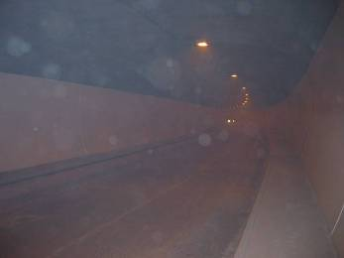

Measuring principle smoke detection
The measuring principle of a smoke detector is based on visibility, which is obtained by a scattered light measurement
Visibility is measured in units expressing the extinction of light over a certain distance, E/m (extinction per meter) or, more convenient, mE/m (milli-extinction per meter)
1 mE/m means the light intensity is reduced by a factor of 10 over a distance of 1000 meters
Light intensity
Distance
1000 m

Slide 14
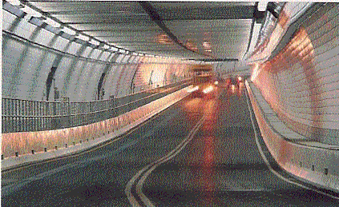
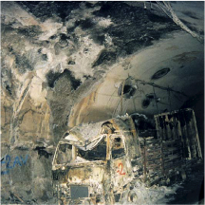
Measured values and their meaning/consequences
Normal traffic < 5 mE/m
Heavy traffic ~ 5 mE/m
Traffic jam ~ 7 mE/m
Closing of the tunnel 12 mE/m
Fire > 15 mE/m

Slide 15

Smoke detector “FireGuard”
Measuring principle: Scattered light
No moving parts
Integrated temperature sensor
Fog elimination with heating elements (option)
Flexible communication and system integration via connection box with various interface modules or directly via WLAN in the sensor
Installation on the wall, ceiling or in the intermediate ceiling of the fresh air channel, integration in the ventilation damper

Slide 16
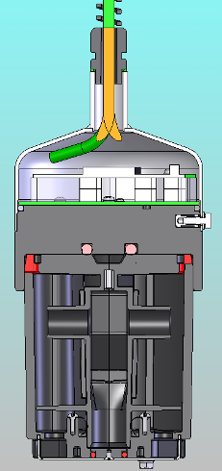
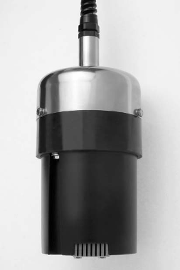
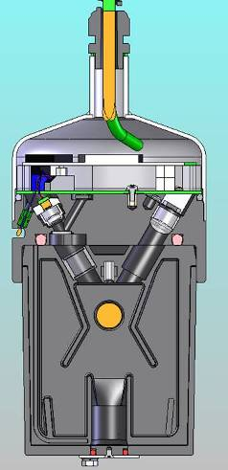
FireGuard: Airflow and optical setup
Reference
beam
Receiver
Temperature
sensor
LED
Light source
Air flow

Slide 17
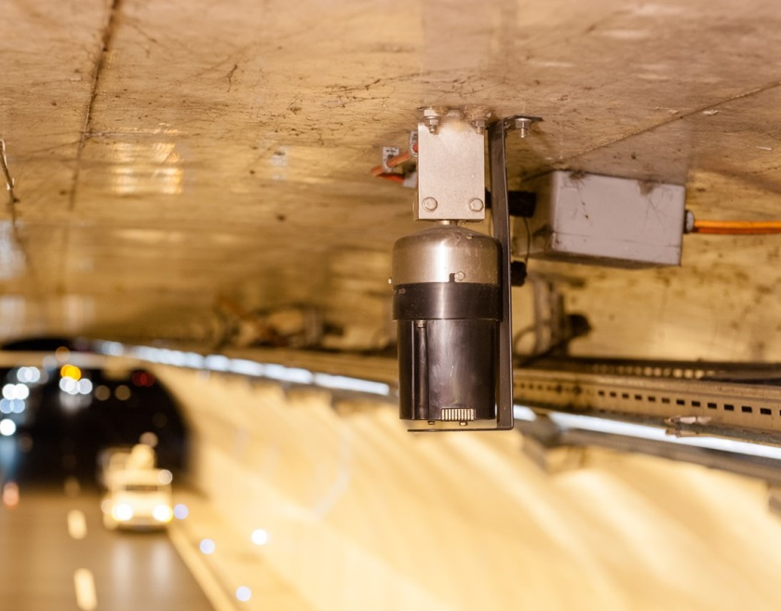
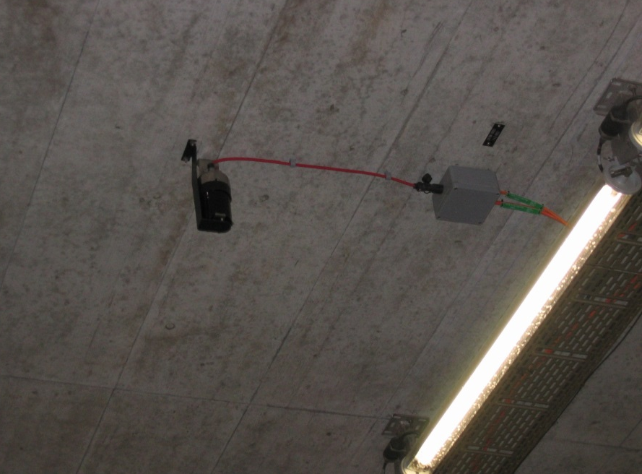
FireGuard: Installation example
Installation of the FireGuard on the ceiling, «Islisberg» tunnel (5 Km)

Slide 18
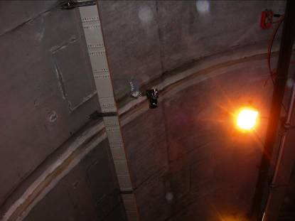
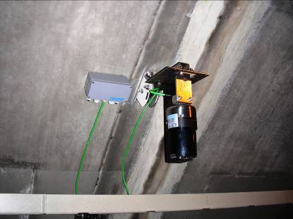
FireGuard: Installation example
Installation of the FireGuard on the wall, «Blatt» tunnel (500 m)

Slide 19
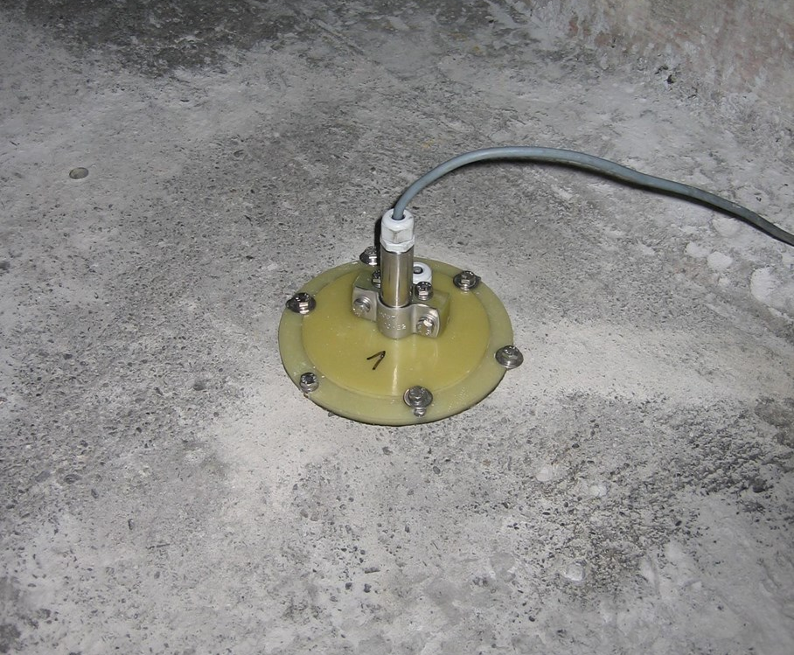
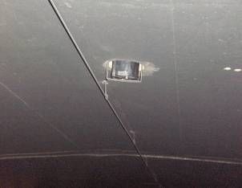
FireGuard: Installation example
Installation of the FireGuard in the intermediate ceiling, «Gotthard» tunnel (16.9 Km)

Slide 20
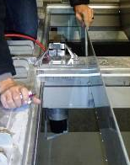
FireGuard: Installation example
Installation of the FireGuard in the ventilation damper, Tunnel «Lungern» (3.5 Km)

Slide 21

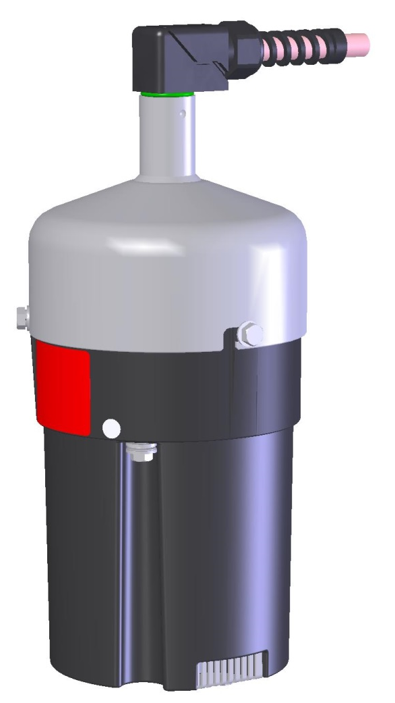
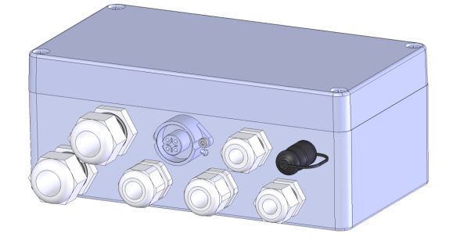
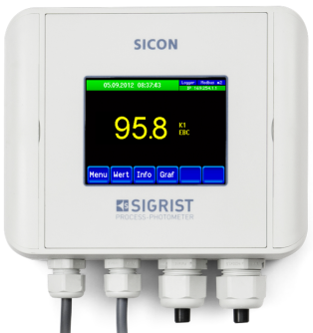
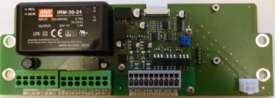
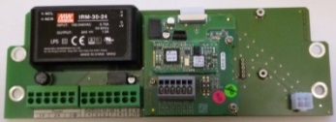
FireGuard – System integration I
Connection box SIPORT 2
Handheld control
unit SICON-C
WLAN Module
(Optional)
or
or
Module
Modbus RTU
Module
StromRel
Module
Profibus DP
FireGuard

Slide 22
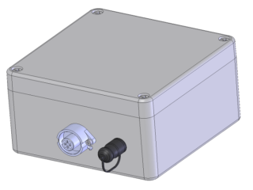
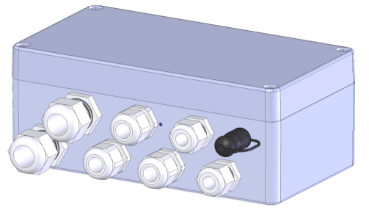
FireGuard – System integration II
Handheld control unit SICON-C
WLAN Module
(Optional)
Connection
box V1
Connection box
SIPORT 2
or
Module
StromRel
or
Module
Modbus RTU
FireGuard
Module
Profibus DP

Slide 23
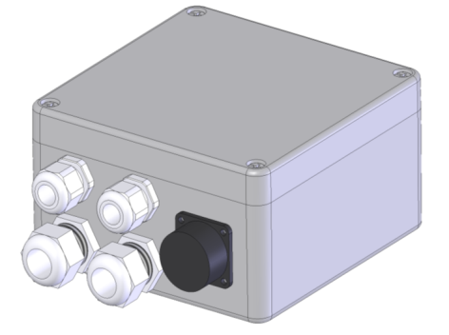
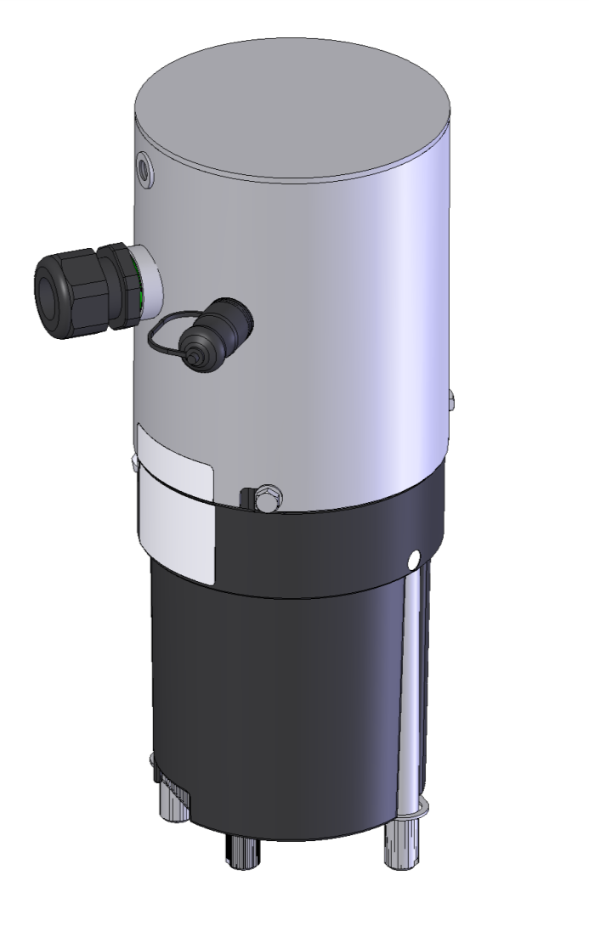
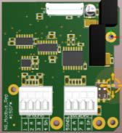

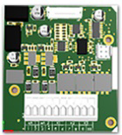
FireGuard «Integral» system integration
WLAN Module
(Optional)
Connection
box V2
Module
Modbus RTU
or
or
Module
Profibus DP
Handheld control unit SICON-C
Module
PowerRel
FireGuard Integral

Slide 24
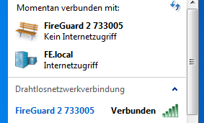
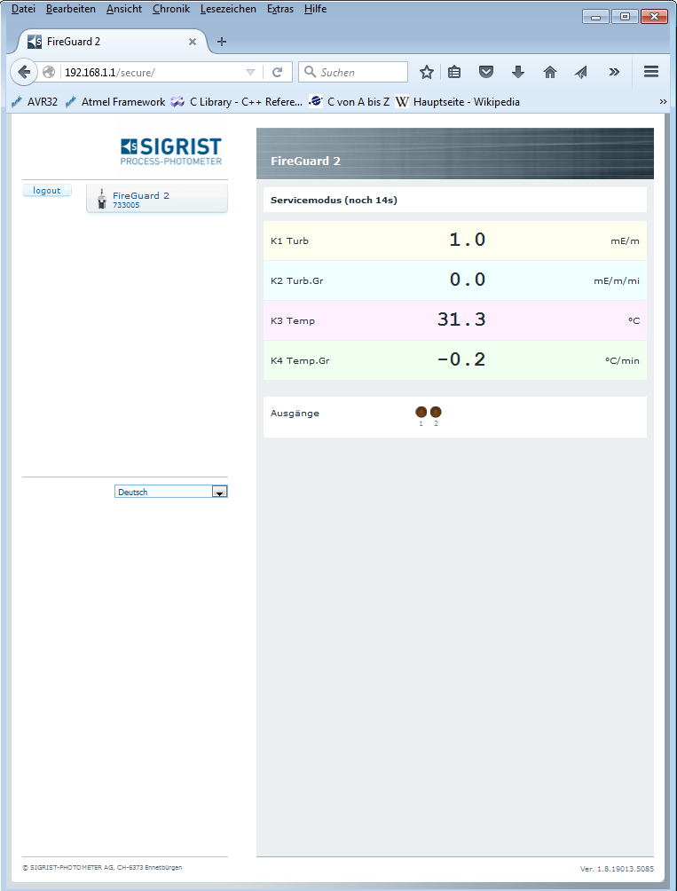
FireGuard – optional WLAN module
Currently connected with:
Sensor is shown as “Access Point”
  Connection is done as with any normal access point
Address 192.168.1.1
Only one sensor can be connected at the same time to the access point
The connection is separated after 2 minutes if there’s no data traffic
No internet connection
Internet connection
Wireless network connection
Connected

Slide 25


FireGuard: Parameterisation
Correct parameterization is crucial for a reliable and error-free function
The alarm level must be set low enough so that also small incidents are detected
The alarm level must at the same time be set high enough to avoid false alarms
  Typical limits are 10-12mE/m for the
  pre-alarm, 30mE/m for the main alarm
The optimum parameters must be defined individually for each object
  Correct parameterization = 0 false alarms! (experiences Gotthard tunnel)

Slide 26
Example of a reliable handling of an incident*
7 ½ minutes
Smoke affected area
300 m
1’000 m
* Smoke development from a passenger coach in the Gotthard tunnel, November 8, 2013

Slide 27




FireGuard: Service & maintenance
The only maintenance effort includes a cleaning of the measuring chamber
  The sensor has a built-in monitoring which informs about the soiling
  According to the operator of the Gotthard tunnel, cleaning once every five years is sufficient (the decision is made based on the soiling indication)
  Tool less version optionally available
After cleaning an automated calibration, using a control unit, is performed
Time required per sensor:
  About 20-25 minutes if cleaned on the spot
  About 15 minutes if the measuring chamber is exchanged and cleaned at a later time

Slide 28




FireGuard: Service & maintenance
FireGuard from the Gotthard tunnel, installed since September 2007 (Pictures taken on April 30, 2014)

Slide 29

Thank you for your attention
FireGuard, the most genius
fire detector:
simple – safe - reliable

