Slide 1
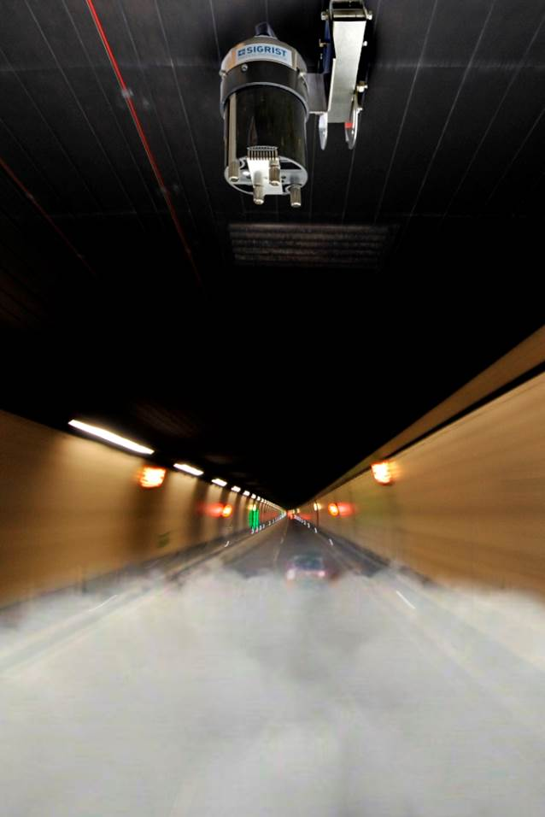
FireGuard 2
USP & Product Advantages » Customer Benefit

Slide 2
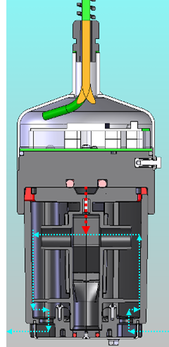
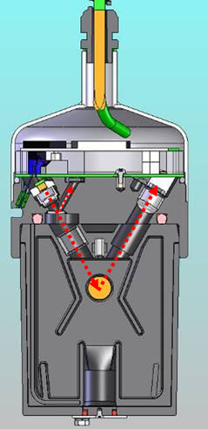
Compact design – no moving parts
The sensor uses the natural existing air stream in
the tunnel:
In the instrument, there are no moving parts (e.g. blower)
No risk of a failure due to wear
Extremely low operating costs

Slide 3
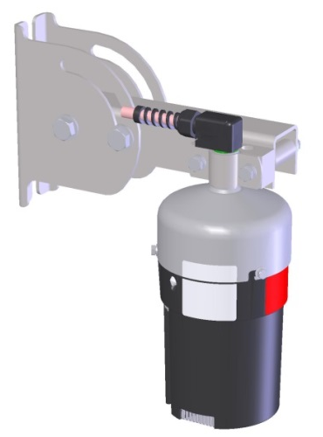
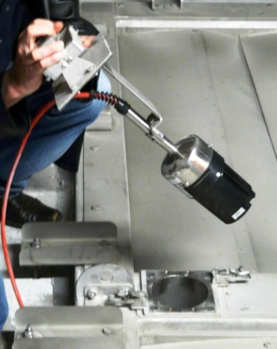
Various installation options
The FireGuard is available in different versions for
various mounting:
Adjustable mounting bracket (0 – 90°) for
the installation on the wall or on the ceiling, regardless of the tunnel profile
Special installation kit for the installation in the intermediate ceiling available
Possibility to install directly into the tunnel ventilation dampers

Slide 4
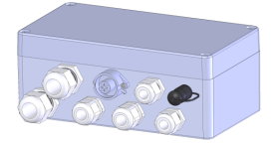
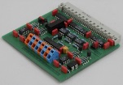
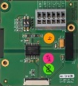
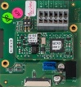
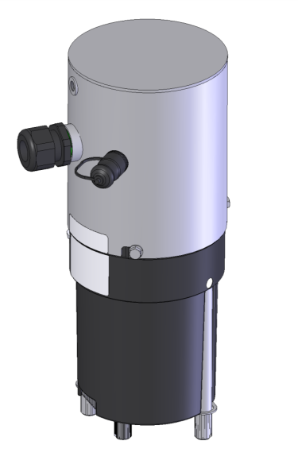
Flexible System integration
The integration of the FireGuard in new or existing tunnels is easy and flexible done using a modular designed connection concept:
Connection box with various modules and optional connection plug
Modern interface modules for Profibus DP, Modbus RTU, Power/Relays and WLAN for an individual tailored system integration
Simple parametrization using a handheld operated unit or via WLAN
Model “Integral” with integrated connection box

Slide 5
LED light source
SIGRIST uses the well-proven LED-technology since
1998. LED’s have the following advantages:
Very low power consumption = low operating cost
Very long life span, typically > 10 years. Therefore, no regular change of the light source is required
Very stable light intensity over the whole life span, therefore, literally no drifts. One calibration check
per year is sufficient

Slide 6
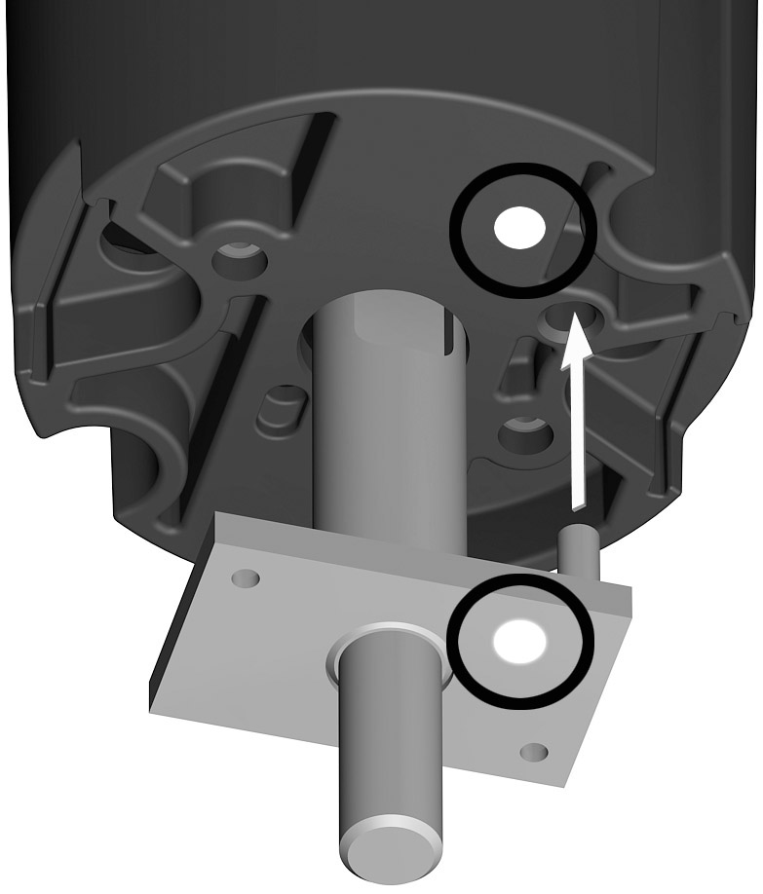
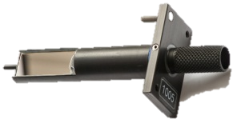
Easy calibration using a calibration rod
Since decades, SIGRIST offers so called secondary
standards for checking and adjusting the calibration:
Fast and reliable calibration without any tools
The FireGuard recognizes the checking rod and performs the calibration automatically within less than 30 seconds
Works independent from the current air quality existing in the tunnel

Slide 7
Continuous system monitoring in the background
Avoiding false alarms is one of the most important
criteria for a reliable smoke detection. The intelligent
electronic monitors all relevant parameters in the
background:
High reliability, no false alarms
System status through LED visible on the sensor
Soiling monitoring, user adjustable

Slide 8
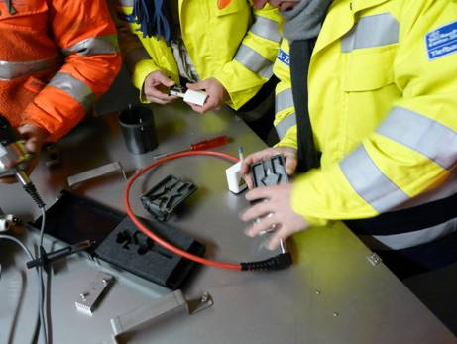
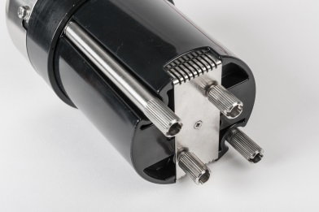
Easy maintenance
There’s limited time available for the
maintenance of tunnel sensors. Maintenance
of the FireGuard is very easy and quick:
Dismantling of sensor without any special tools
Tool less sensors are optionally available
Maintenance interval is typically once every 2-5 years
Maximum time needed is 15 – 25 minutes per sensor

Slide 9

Extremely low maintenance cost
SIGRIST instruments are known for a low total
cost of ownership. The FireGuard is no
exception:
No parts subject to wear and tear
No consumables
No need for lamp changing

